Slide 1
Join Our Team

Slide 2
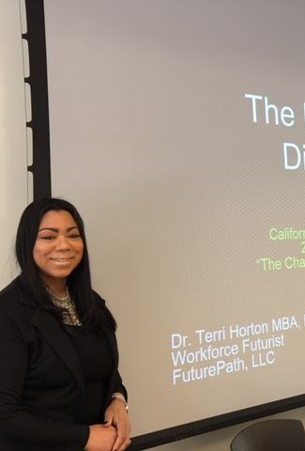
Network, Learn, Serve, Lead
CCDA Has Many Opportunities For Career Development Professionals And Students
Plan Local Chapter Events
Plan Regional Conferences
Gain Leadership Experience On Our Board
Share Your Expertise As A Workshop Facilitator
Advocate For The Field Of Career Development
Publicize Events And Opportunities On Social Media
Recruit New Members

Slide 3
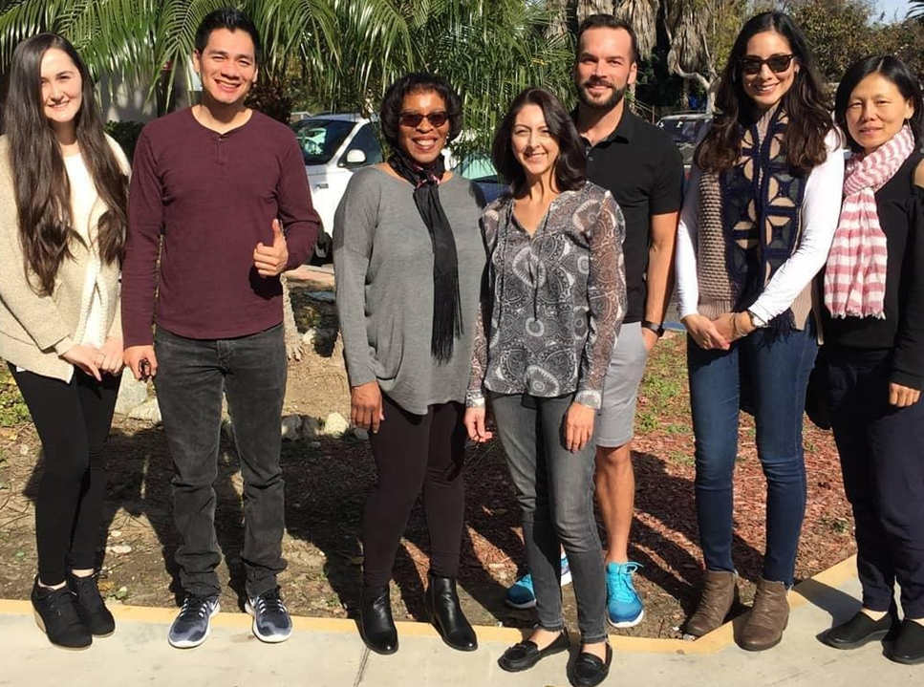
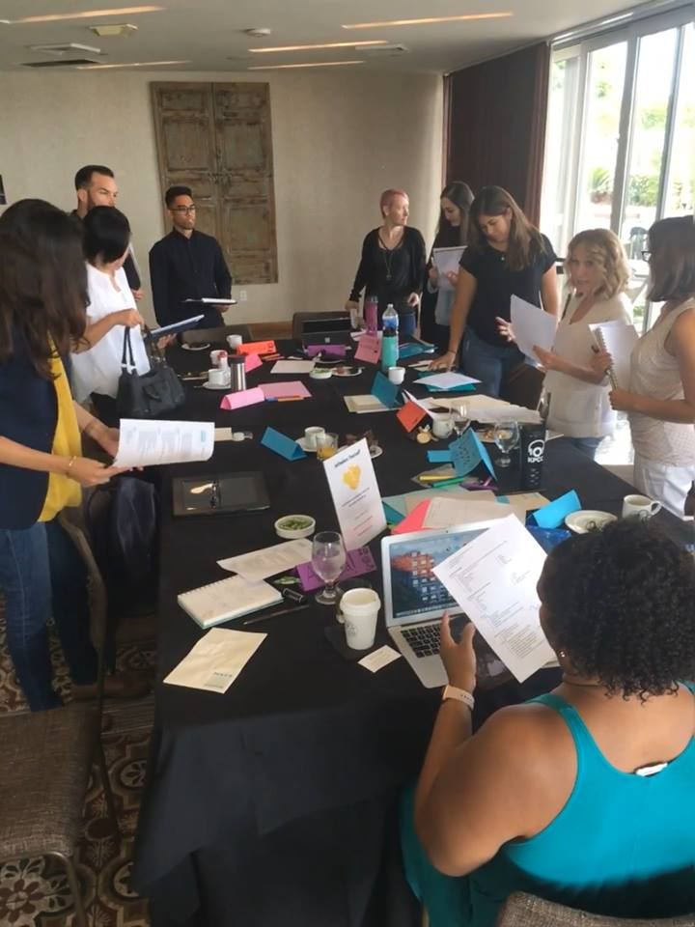
Opportunities for Elected Positions and Positions at Large
Business and Industry
Community Partnerships
Association Relations
Marketing and Public Relations
Conference
Finance
Private Practice
Higher Education
K-12
Advocacy
President-Elect
Treasurer/Finance Chair
Secretary

Slide 4
Board and Committees
Finance Committee
Communications, Member Services and Marketing Chair
Social Media Committee
Collaborations and Outreach
Technology Committee
Grad Student Representative
Regional Chapters Coordinators- NoCal and SoCal
Regional Chapter Leaders
Conference Planning Committee (sponsorships and exhibitors)

Slide 5
Plan CCDA Events
Take Charge of Your Own Professional Development
What do you want to learn?
Plan Chapter workshops, social events & mixers
Plan state-wide annual conference
Recruit speakers
Choose conference themes and workshops
Network with professionals as an event volunteer
Meet experts in the field of career development

Slide 6
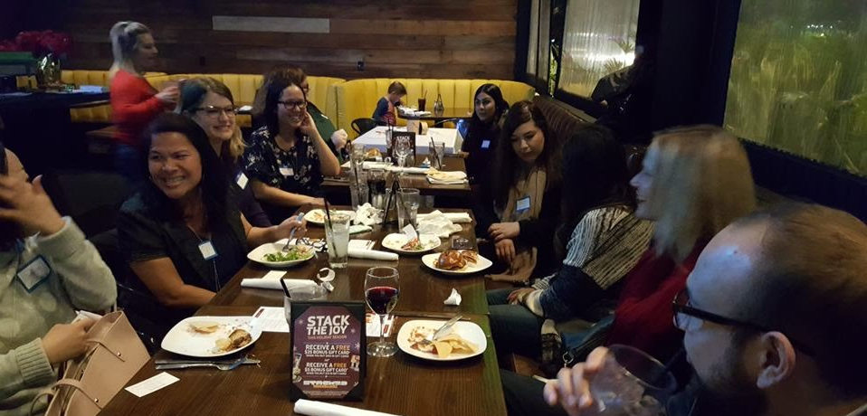
It’s Who You Know
Many CCDA volunteers have obtained meaningful employment through CCDA contacts
CCDA member are mentors
CCDA professionals are great resources for industry knowledge
CCDA members share best practices
CCDA members refer clients to other CCDA members
Need a guest speaker? CCDA members help you find industry experts
Leadership and volunteer service in your field looks great on your resume

Slide 7
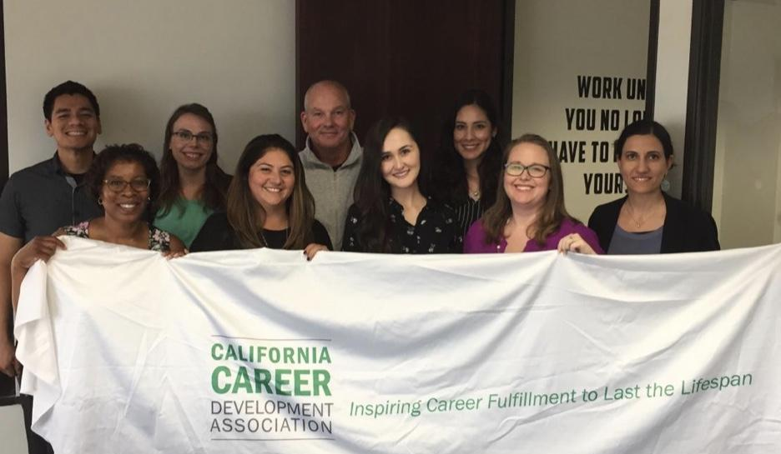
Learn A Skill, Share A Skill
Leadership
Event Planning
Social Media
Marketing
Nonprofit Management
Web Design
Accounting
Legislative Advocacy
Recruitment

Slide 8
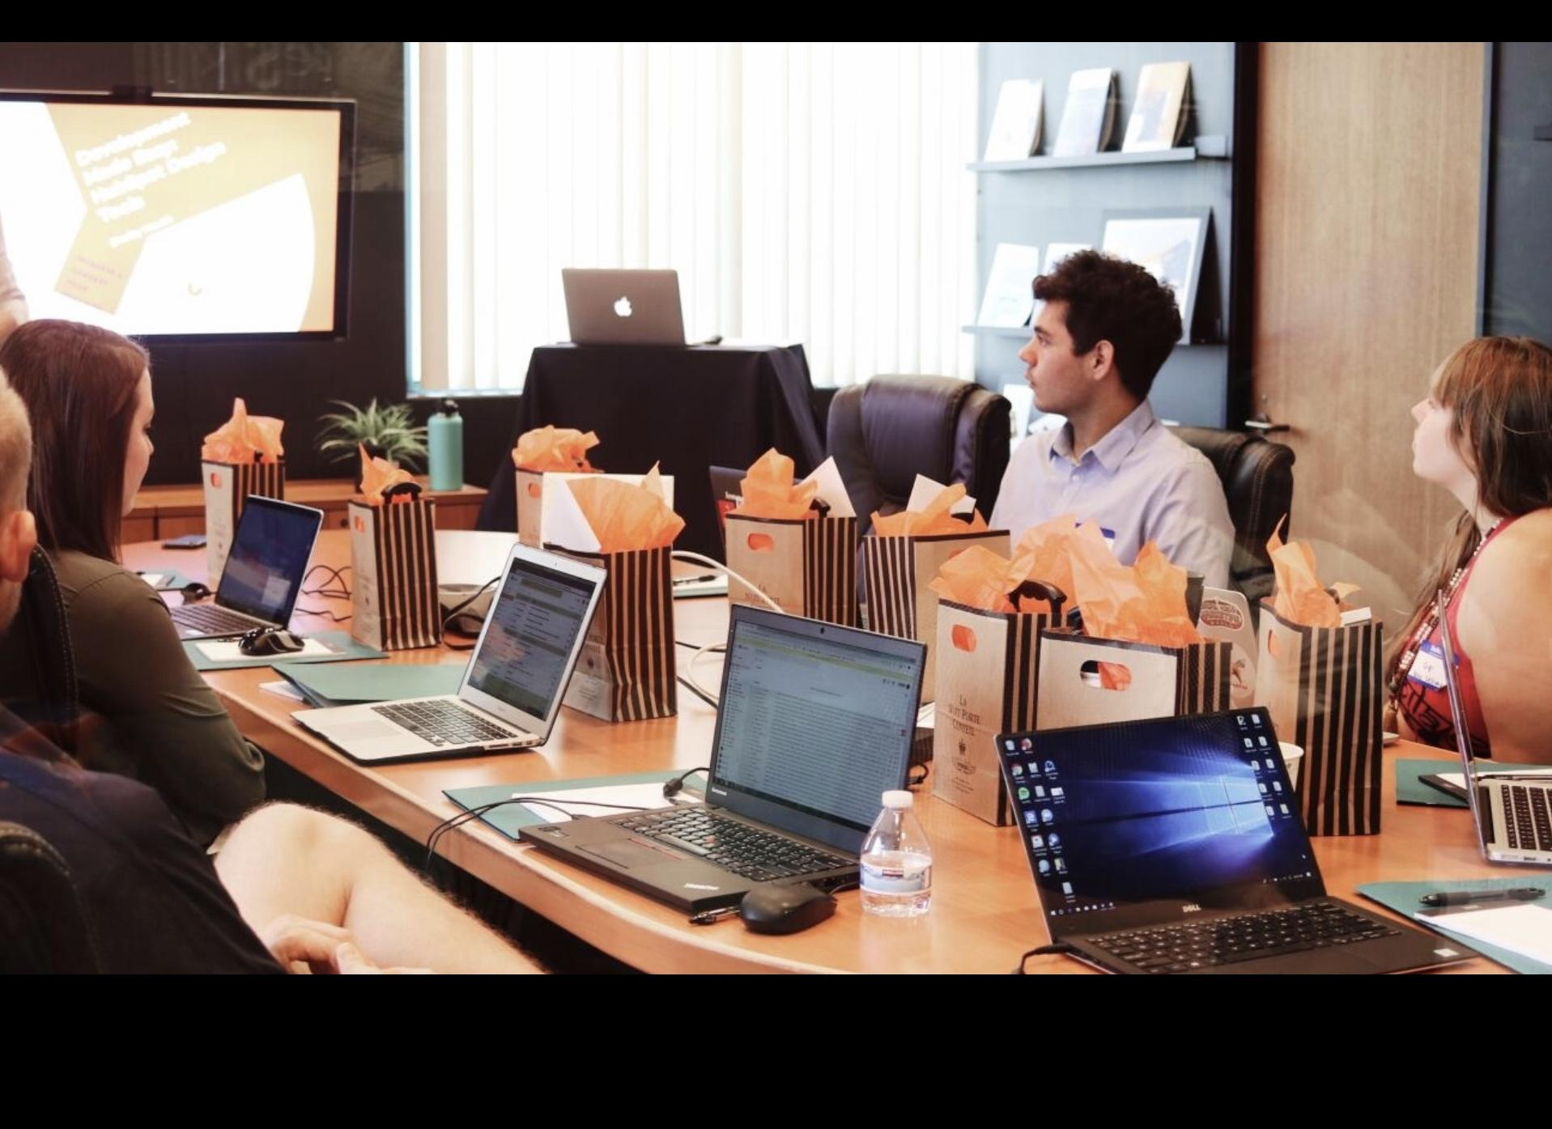
Got Meeting Space?
Bring awareness to your work-place by hosting a CCDA event
Donating meeting space reduces the cost of CCDA events
Showcase unique services and products by hosting an event

Slide 9
Advocate For Career Development
Educate the public about career development
Volunteer for career education events
Help influence public policy regarding career & employment issues
Publicize important legislation regarding career development & employment
Share your enthusiasm for your industry

